Slide 1
DEL NORTE
SISKIYOU
MODOC
SHASTA
LASSEN
TRINITY
TEHAMA
PLUMAS
SIERRA
BUTTE
NEVADA
PRISON TO EMPLOYMENT ASSET MAP/ SERVICE AREA

Slide 2
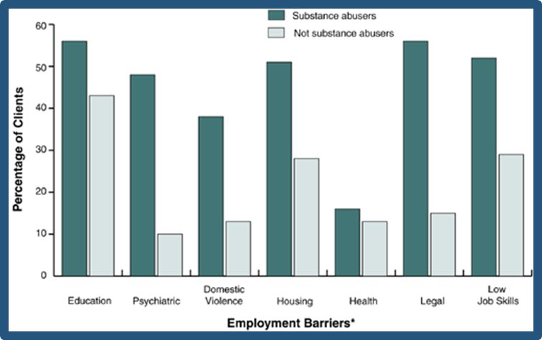
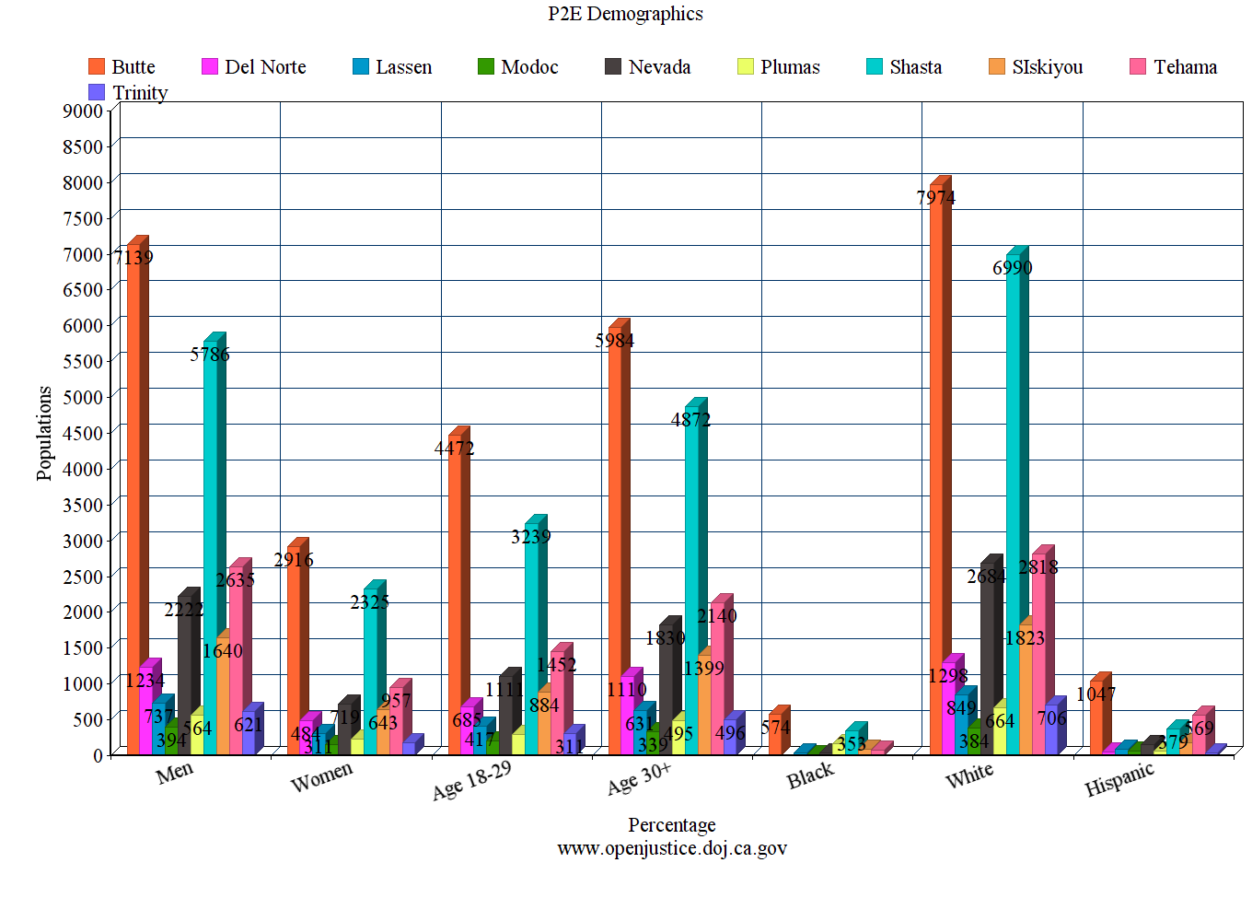
P2E Planning Meetings (No surprises)
Parole/Probation Agency | Client population | Population size | Services provided | Service gaps | Required Outcomes | Meeting outcomes? | Existing Partners | Data collection | Veterans Svcs?

Slide 3
Our Solution/model “The big 3” Holistic case management
#2 – Basic Needs
#3 – Employment plan
#1 – law enforcement lead
If the client doesn’t meet the requirements of Parole, probation, or the court, nothing we do helps
(right now)
If a client has real life stressors, including substance abuse issues, housing, food/clothing, children, etc., they cannot focus on obtaining and retaining a job
Heavily reliant on Business services knowing the client and the employers
Key employers/opportunities
Notes:
Heather - This is a shared philosophy. Educate the client of their court ordered classes, fines, terms and conditions.
Connect them to resources that can help meet their basic needs – not a referral paper but a warm hand off and perhaps transporting them to the agency or scripting what they’re going to ask for.
Stable employment is often cited as the most important component in reducing recidivism, but it requires a readiness and stability that takes time to cultivate.
Employment services provide foundation for developing the youth’s financial, housing and vocational plan.
Ron – comments about how probation views this arrangement

Slide 4
The approach: daily contact – JS, LE, WD, emp Housing & Support Services Pro-social/CBI Financial literacy pre-employment boot camp On-the-Job Trainings “Whatever it takes”

